Slide 1

JavaScript Games Michelle Beckett

Slide 2

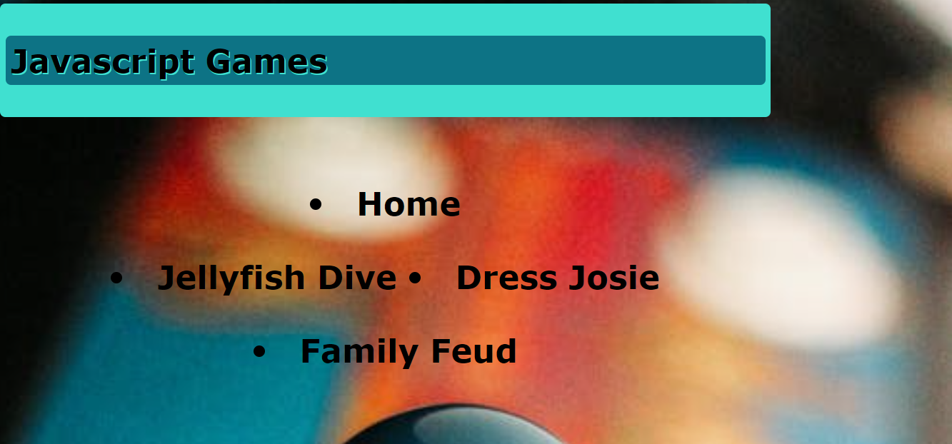
Interface Design
This is the main screen for my interface design for my JavaScript games. The easy interactive interface will simulate a real game situation and offer a more complex game experience.

Slide 3
Jellyfish Dive
I designed a canvas game called Jellyfish Dive. It is an interactive game where a diver has to avoid stinging jellyfish and sharp coral.

Slide 4
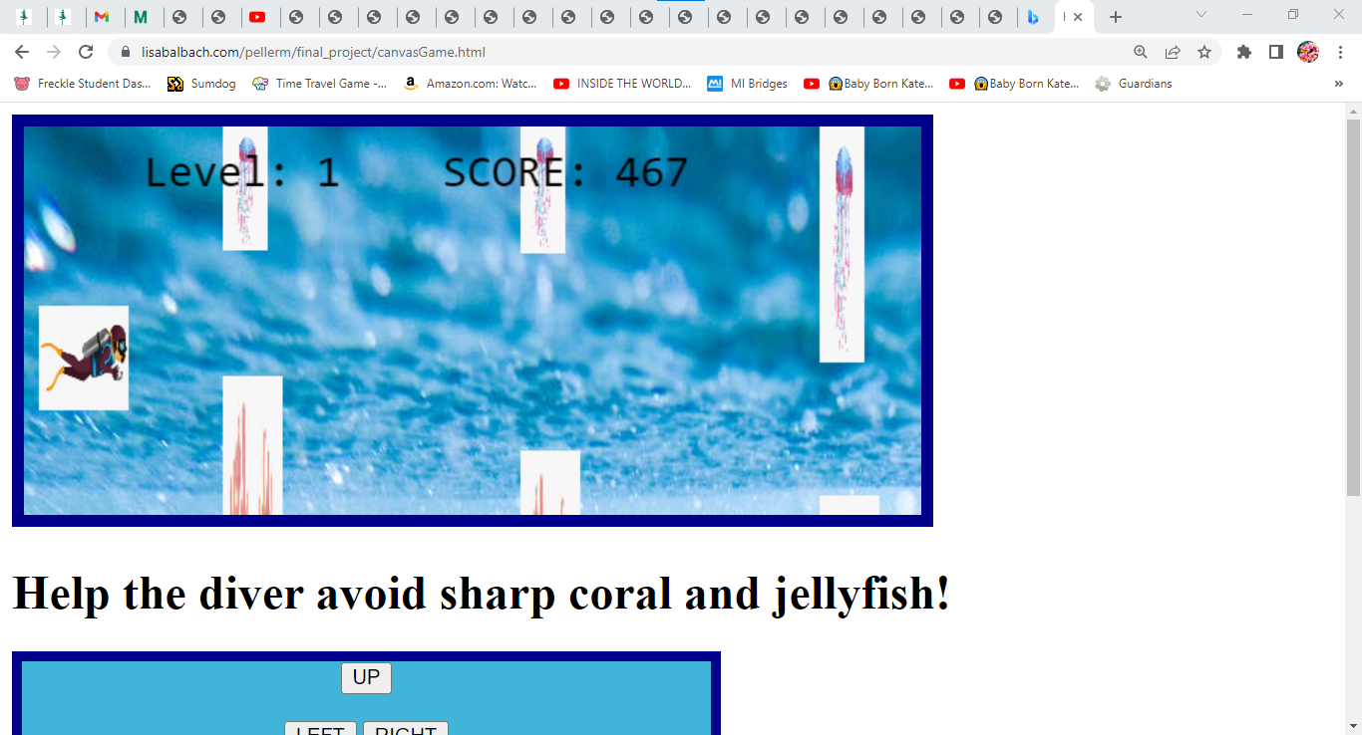
Jellyfish dive
This is the main screen of the canvas game. I added sound effect when the diver is swimming and when the diver hits the rocks and coral.

Slide 5
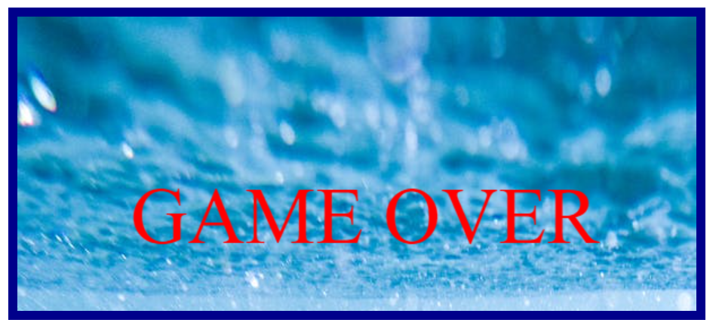
Jellyfish dive
At the end of the game a game over is displayed when the diver hits either the coral or the jellyfish.

Slide 6
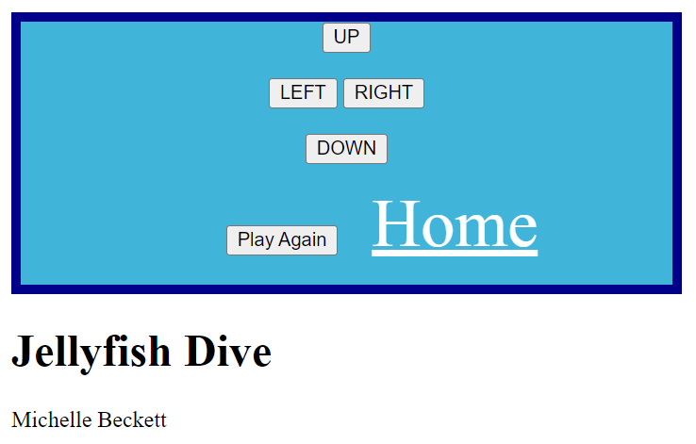
Jellyfish dive
These are the controllers and the home button to take you back to the main screen.

Slide 7
Dress josie
This is an interactive game for you children to drag and drop different clothes to dress a doll.

Slide 8
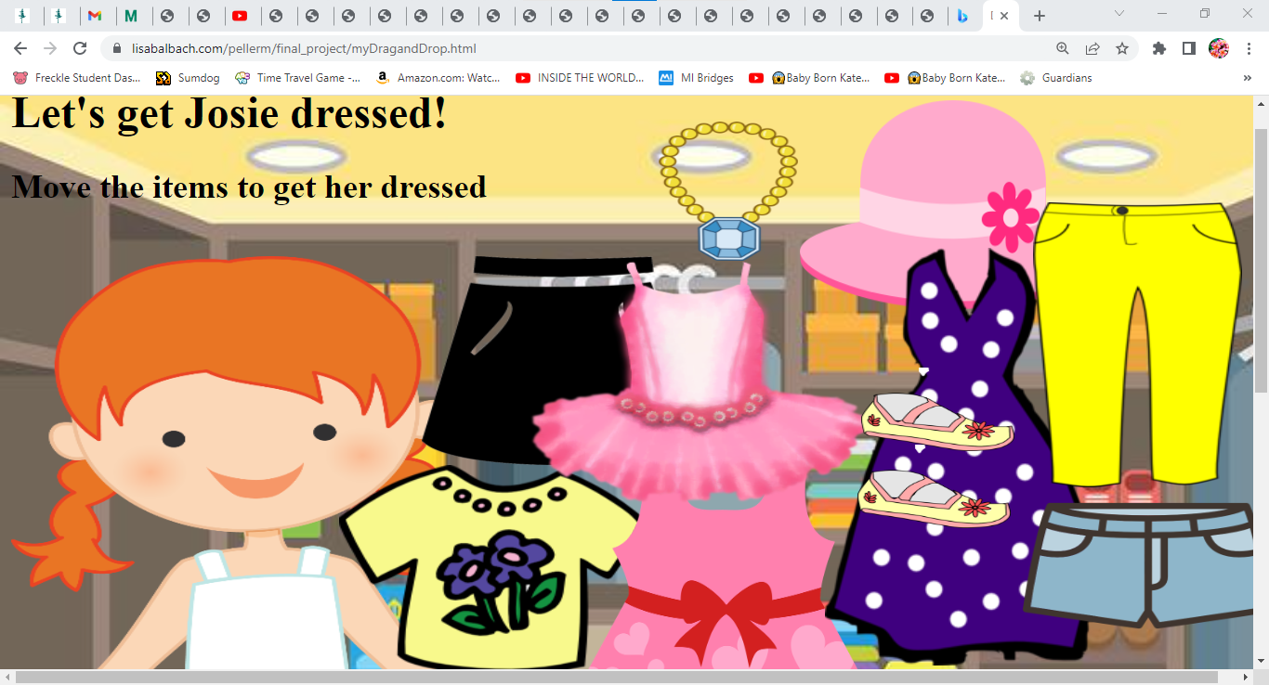
Dress josie
Dress Josie is an interactive game for children 2 and up. Drag and drop the clothing to get Josie dressed for the day!

Slide 9
Problems with Dress josie
One of the problems that I had making this game was trying to make an ordered list (<ol>) to organize all the clothes and accessories into one spot. I tried many methods of lists but could not get it exactly the way I would like it. Within the next week, I would like to figure out how to organize it properly and add sound.

Slide 10

Family Feud
Family feud is one of my family’s favorite game to play together. I am going to design a family friendly animal edition.

Slide 11
Audience
Interactive Features
Each label is highlighted when you hover over it.
- Animations and sound are added to Jellyfish Dive.
These games are suited for anyone between the ages of 5 and up.
Layout Selection
I used the grid layout because it is easy to identify with id’s and it is flexible.
Flexible menu

Slide 12
Background Image
Color Scheme
I went with shades of turquoise and black to compliment the background image.
I went for a zoomed-out pictures of a retro game controller
Menu Design
- The menu design hovers over each game
- It was created with a <nav> <ul> <li> id=“” tags.

Slide 13
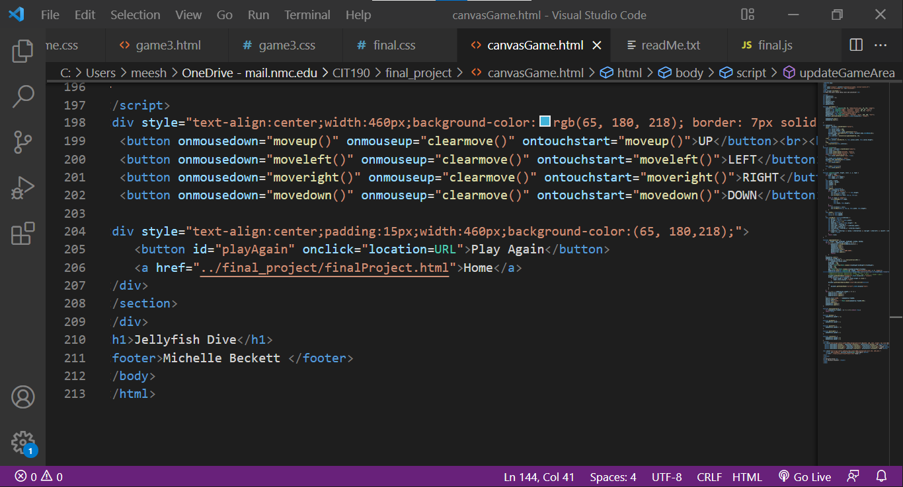
Problems
I had a hard time linking the home button. I tried many different ways without success. I finally made a home button that linked back to my main page.

